Slide 1
Meta-Mathematics of P vs NP
Igor Carboni Oliveira
University of Warwick
Clay Mathematics Institute
Workshop “P vs NP and Complexity Lower Bounds”
1

Slide 2
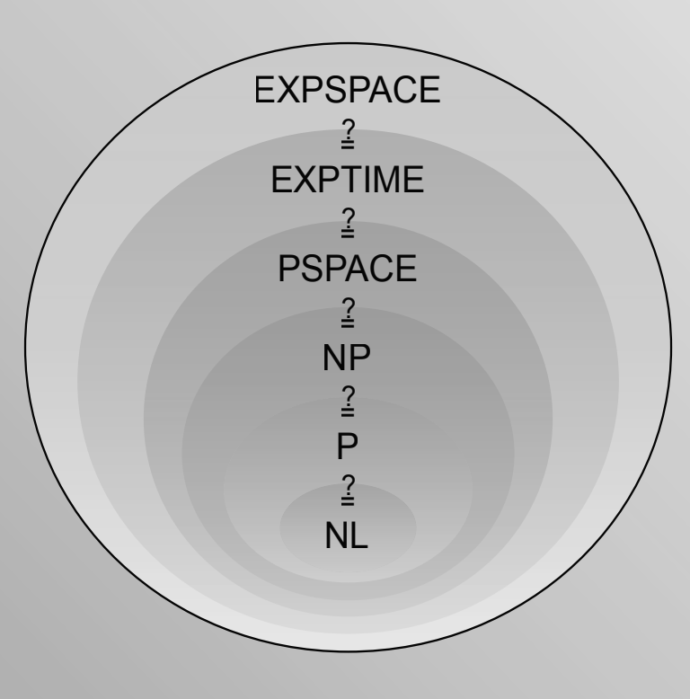
Complexity Theory:
P vs NP, NP vs coNP, …
How difficult is it to solve computational problems?
2^{n}
Best known upper bound for NP problems such as SAT
?
5n
State of the art in circuit lower bounds
CACM March/21
Meta-Mathematics of Complexity Theory
How difficult is it to prove theorems about computational complexity?
2

Slide 3
Plan
Motivation
Theories
Unprovability of Upper Bounds
Unprovability of Lower Bounds
Reverse Mathematics
3

Slide 4
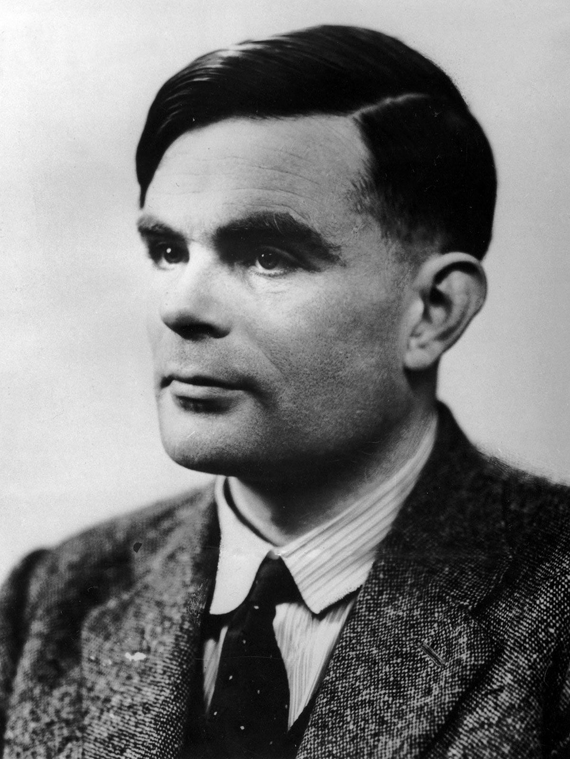
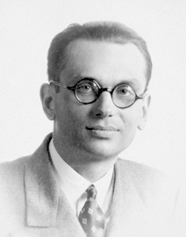
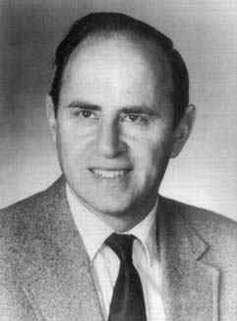
Grand Challenge
Identify a theory T able to formalize all known results from algorithms and complexity, and determine if complexity results of interest are (un)provable in T
Alan Turing
Kurt Gödel
Paul Cohen
4

Slide 5
A less ambitious goal
many
Identify a theory T able to formalize all known results from algorithms and complexity, and determine if complexity results of interest are (un)provable in T
Extensive research has identified a fragment of Peano Arithmetic called Bounded Arithmetic as a relevant theory.
…
Bounded Arithmetic
Peano Arithmetic
ZFC Set Theory
power
5

Slide 6
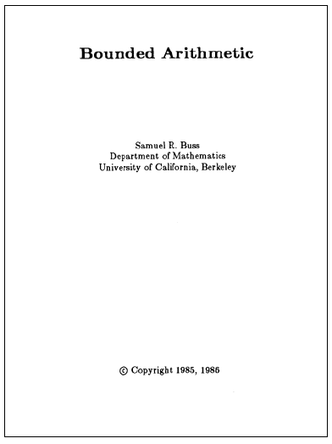
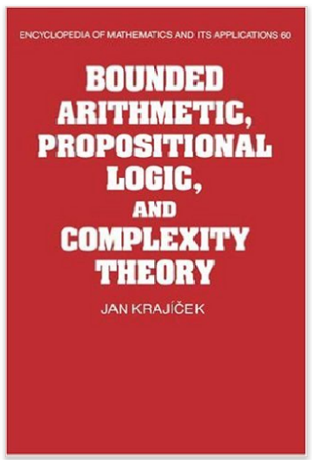
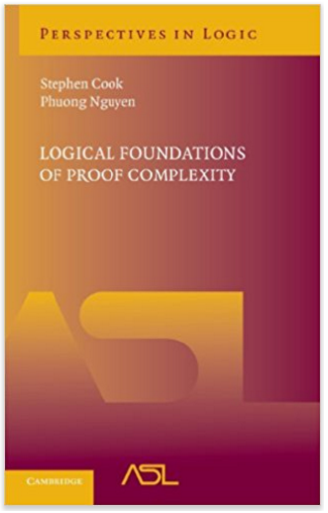
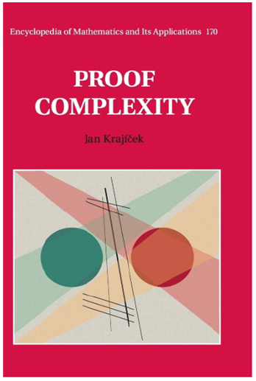
Bounded Arithmetic
Fragments of Peano Arithmetic capturing proofs that manipulate concepts from a given complexity class.
A few notable examples:
- Cook’s theory PV (1975), which formalizes poly-time reasoning
i
i
- Buss’s theories S and T (1986), corresponding to the levels of the polynomial hierarchy
2
2
- Jeřábek’s theory APC₁ (2007) for probabilistic poly-time reasoning
6

Slide 7

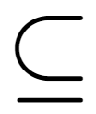
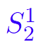
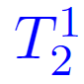
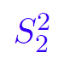
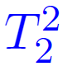
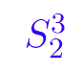
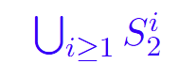
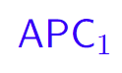
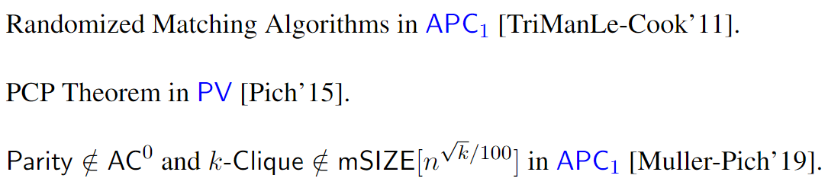
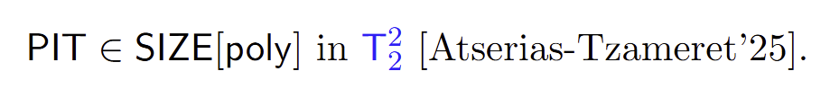
…
BA (Bounded Arithmetic)
Several results from Algorithms & Complexity can be formalized in BA:
7

Slide 8

Meta-Mathematics of P vs NP
Most researchers believe that P ≠ NP.
Can we at least rule out a proof that P = NP in BA?
(i.e., for no poly-time algorithm A, PV proves that A solves SAT)
From the perspective of “feasible mathematics”, a world where P ≠ NP !
Obtaining this result is formally necessary before we can prove that P ≠ NP.
8

Slide 9
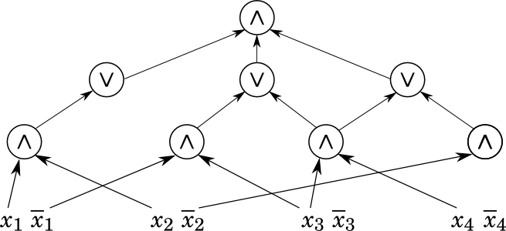
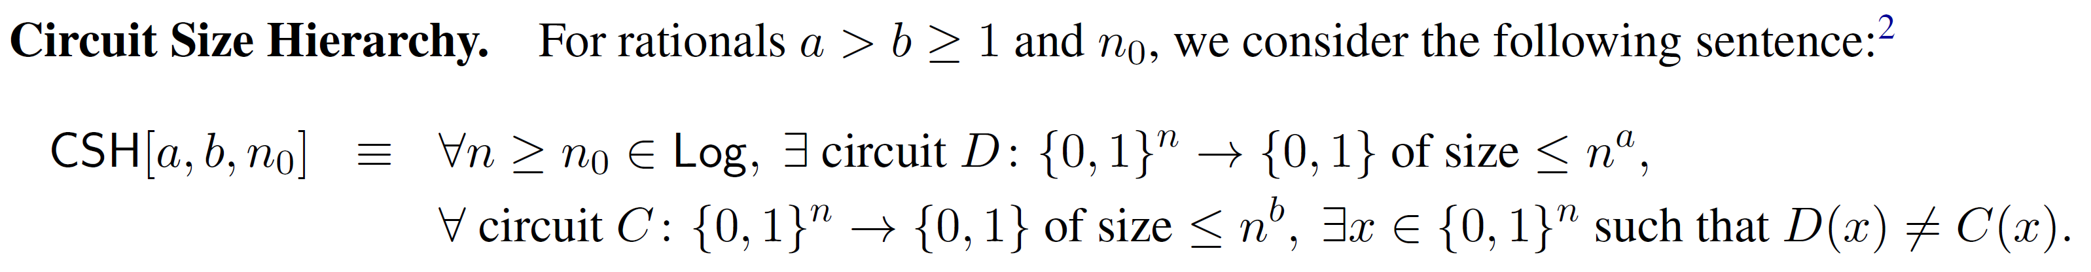
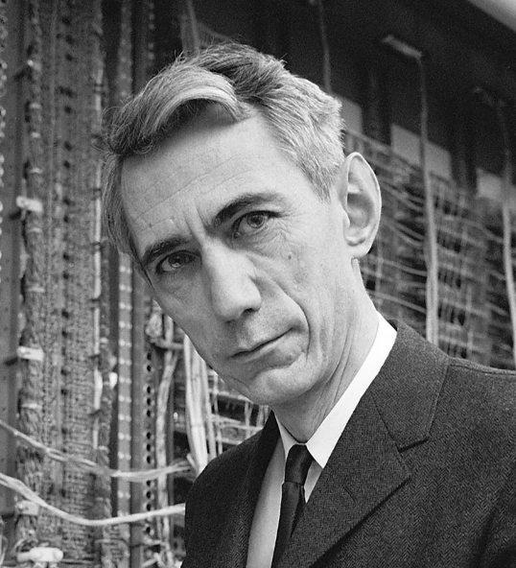
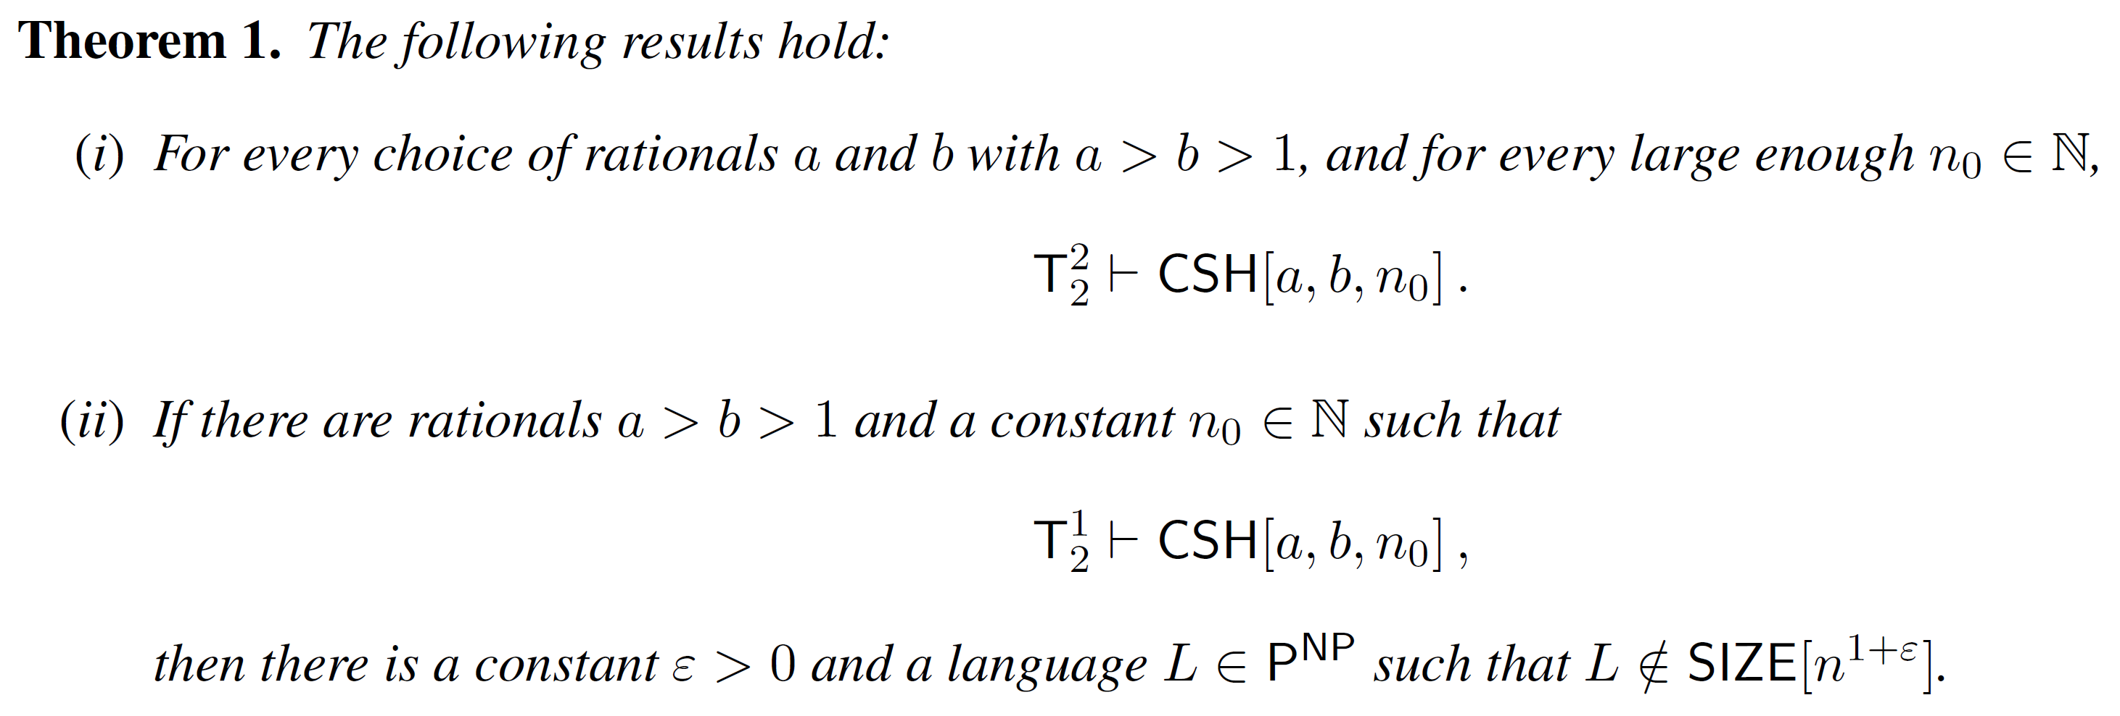
From Meta-Mathematics to Complexity Theory
Joint work with M. Carmosino, V. Kabanets, A. Kolokolova, and D. Tsintsilidas (2025)
Claude Shannon
9

Slide 10
Plan
Motivation
Theories
Unprovability of Upper Bounds
Unprovability of Lower Bounds
Reverse Mathematics
10

Slide 11
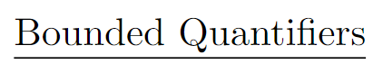
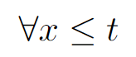
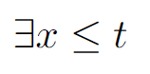
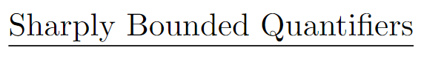
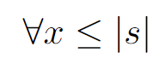
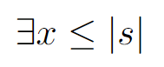
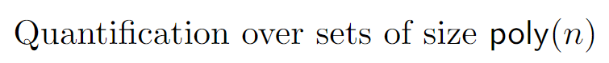
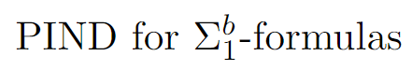
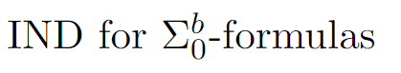
…
11

Slide 12
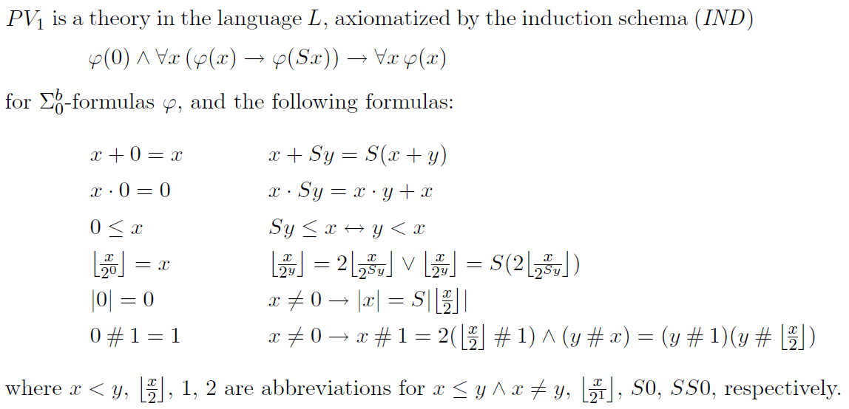
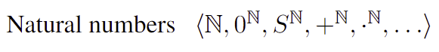
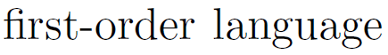
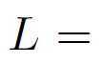
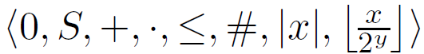
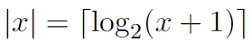
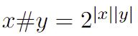
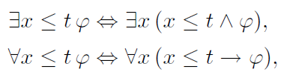
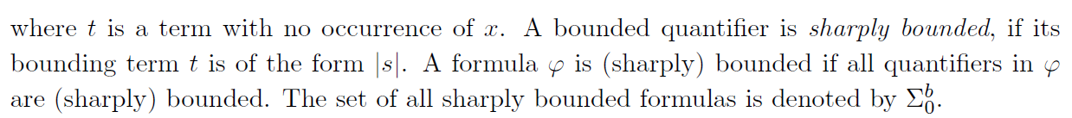
PV (Jeřábek’s Equivalent Formulation as T⁰)
2
Intended model:
Intended meaning of the symbols:
Bounded quantifiers & sharply bounded quantifiers:
12

Slide 13
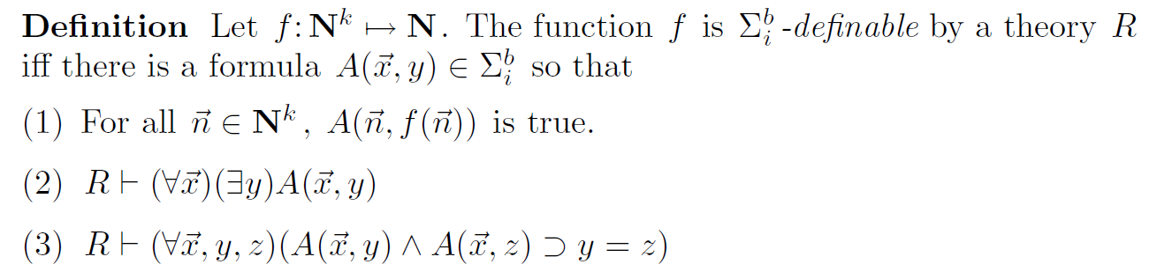
Formalization of complexity statements
Relevant Facts:
Since we can refer to any polynomial time computation in a sentence, we can capture complexity statements in a natural way.
Example. A non-uniform circuit upper bound for a language L in P:
For every N (with n=|N|), there is a circuit C with |C| < n³, for every n-bit string x, C(x) = L(x)
13

Slide 14
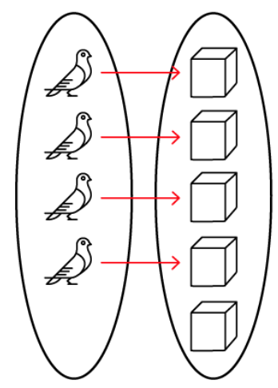
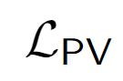
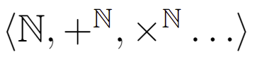
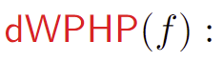
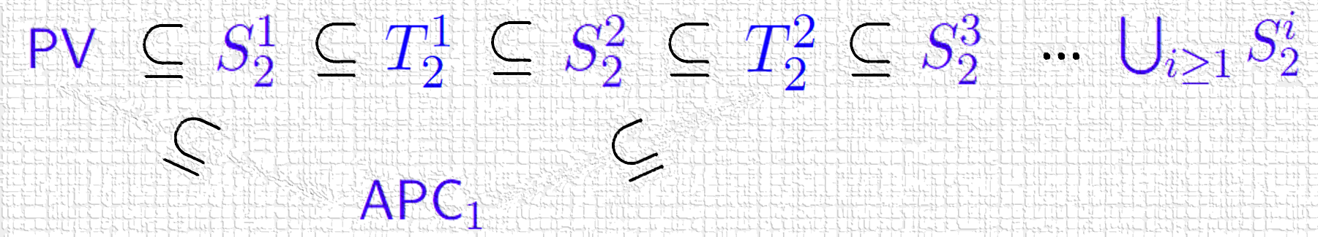
Theory APC₁
[Jeřábek 2007]
Vocabulary:
Intended Model:
Natural numbers
14

Slide 15
Plan
Motivation
Theories
Unprovability of Upper Bounds
Unprovability of Lower Bounds
Reverse Mathematics
15

Slide 16
Want to rule out efficient algorithms/circuits with respect to a logical theory T
Relax our goal of showing that P ≠ NP, NP ⊈ SIZE[n³], etc. to
Theory T does not prove that P = NP
Theory T does not prove that NP ⊆ SIZE[n³]
Systematic investigation
initiated by S. Cook and J. Krajíček:
Necessary before showing corresponding lower bounds
16

Slide 17
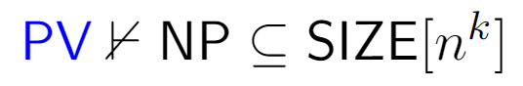
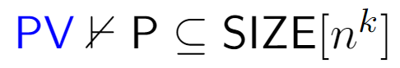
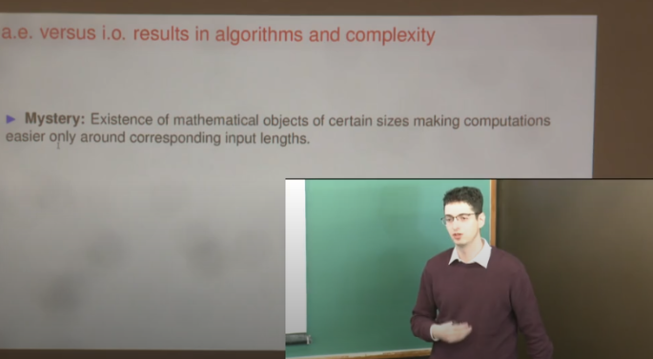
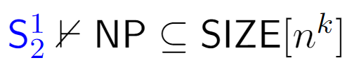





Unprovability of Upper Bounds
Fix any positive integer k. Then
[Krajicek-O’17]
Unconditional
[Bydzovsky-Müller’19]
[Bydzovsky-Krajicek-O’20]
[Carmosino-Kabanets-Kolokolova-O’21]
[Atserias-Buss-Müller’23]
[Thapen’25’]
17

Slide 18


P vs NP
18

Slide 19






Reduction to the unprovability of lower bounds
Observation from a joint work with J. Bydzovsky and J. Krajicek (2020)
Therefore, if circuits lower bounds are unprovable, P = NP is unprovable.
19

Slide 20
Plan
Motivation
Theories
Unprovability of Upper Bounds
Unprovability of Lower Bounds
Reverse Mathematics
20

Slide 21
Unprovability of Lower Bounds
Known lower bounds: weak and distant from main goals such as P vs NP
Barriers: relativization, natural proofs, algebrization, …
Useful, but tend to be formulated in an ad-hoc way and are limited in scope
Motivates the development of a principled approach to understand the difficulty of analyzing computations (via mathematical logic)
Intriguing possibility: strong complexity lower bounds might be unprovable
21

Slide 22
Some recent unconditional results
Razborov, Krajíček (1995) initiate a systematic investigation of the formalization/(un)provability of complexity lower bounds in bounded arithmetic.
…
(subject is investigated both in bounded arithmetic and propositional proof complexity)
Pich and Santhanam (2021) show the unprovability of strong complexity lower bounds in PV
and in a fragment of APC₁
Li and Oliveira (2023) extend the techniques to APC₁ and stronger theories
(but must consider even stronger lower bound statements)
Chen, Li, and Oliveira (2025): unprovability of worst-case poly-size lower bounds in intuitionistic BA.
22

Slide 23
Pich-Santhanam (Informal)
[PS’21] considers strong complexity lower bounds separating NP from coNSIZE:
Fix a poly-time nondeterministic TM M.
[PS’21] considers a sentence S_{M} stating that
For every input length n > n₀
For every co-nondeterministic circuit D of size 2^{nε}
M and D disagree on 1% of the inputs in {0,1}^{n}.
They showed that S_{M} is not provable in PV and in a fragment of APC₁
23

Slide 24



APC₁ cannot prove strong lower bounds separating the third level of the polynomial hierarchy
[Li-Oliveira, 2023]
24

Slide 25

Discussion
[PS’21]
The results of [PS’21] and [LO’23] are unconditional but only apply to significantly strong lower bounds.
We’d like to understand the (un)provability of major open problems, such as showing that NP ⊈ P/poly.
For this, we need to address the following aspects for which these statements are stronger than NP ⊈ P/poly:
(1) They consider average-case instead of worst-case complexity.
We address the first two issues in the more restricted setting of intuitionistic logic.
(2) Refer to sub-exponential size instead of polynomial size lower bounds.
(3) Against co-nondeterministic instead of deterministic circuits.
25

Slide 26

Unprovability in Intuitionistic S
1
2
Joint work with L. Chen and J. Li (2025)
[S. Buss, 1986]
Able to formalize non-trivial lower bounds:
26

Slide 27



Proof Techniques
Main Technical Contribution
Solves an open problem from [Ats’06]
27

Slide 28


On Refuters for SAT
28

Slide 29
Plan
Motivation
Theories
Unprovability of Upper Bounds
Unprovability of Lower Bounds
Reverse Mathematics
(unprovability of very weak lower bounds, under crypto assumptions)
29

Slide 30




Reverse Mathematics of Lower Bounds
Joint work with L. Chen and J. Li (2024)
We aim to determine the fundamental principles needed to establish lower bounds, by showing (over a weak base theory) that the lower bound and the principle are equivalent.
30

Slide 31
Overview of Results [CLO’24]
I) Equivalences between combinatorial principles, communication complexity, and Turing machine lower bounds over PV
II) Consequences for the (un)provability of lower bounds
31

Slide 32

Weak Pigeonhole Principle for Polynomial Time Functions
32

Slide 33

Equivalence Class for WPHP’(PV)
Suggests complexity lower bounds
can be seen as fundamental
mathematical principles.
33

Slide 34

Corollary
There are simple lower bounds that cannot be proved in APC₁ (under crypto assumptions):
34

Slide 35

35

Slide 36
Further Consequences of Reverse Mathematics
We precisely capture the strength of different communication complexity lower bounds
APC₁ proves one-way communication lower bounds for Set Disjointness.
APC₁ is unlikely to prove one-way communication lower bounds for Equality.
rWPHP(PV)
WPHP(PV)
36

Slide 37
Concluding Remarks
37

Slide 38

…
Bounded Arithmetic
Peano Arithmetic
ZFC Set Theory
…
power
…
38

Slide 39



…
Bounded Arithmetic
Peano Arithmetic
ZFC Set Theory
…
power
Some papers from the last 12 months
…
38

Slide 40


…
Bounded Arithmetic
Peano Arithmetic
ZFC Set Theory
…
power
More Approachable Open Problems:
…
A Fundamental Challenge:
reduction to unprovability of lower bounds
Survey
(supported by reverse mathematics)
“Meta-Mathematics of Complexity Theory”
Published March/2025
38

